Slide 1







D.A.I.S.Y
Domestic A I SYstem

Slide 2




OVERVIEW
D.A.I.S.Y is an AI-powered voice assistant that interacts conversationally with users, performing tasks and answering queries based on voice commands.
It is designed to be user-friendly, responding intuitively and naturally, with a quick response time for seamless interactions.

Slide 3



MODULES
SPEECH RECOGNITION
PYTTSX3
REQUESTS
Captures and transcribes spoken commands, enabling DAISY to listen and understand user input accurately.
Converts DAISY's textual responses to voice, using customizable speech settings (such as rate and volume) to create a natural-sounding output.
Facilitates API communication with DAISY's backend (Ollama), allowing DAISY to generate accurate responses by querying a local large language model.

Slide 4

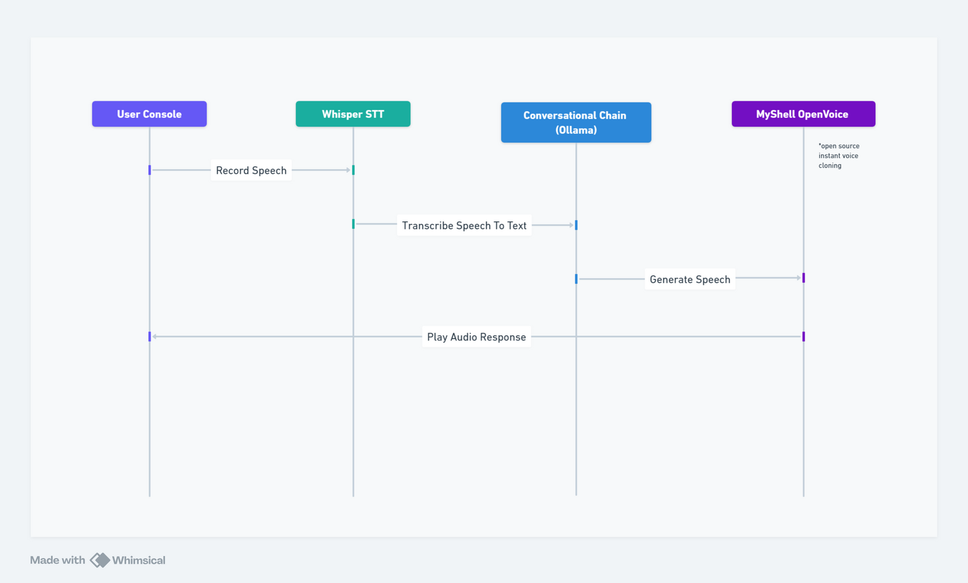


FLOWCHART

Slide 5



CHALLENGES
Model Latency
Ensuring a quick response time from the local AI model was essential for a smooth user experience.
Hardware Limitation
Running an LLM locally can be resource-intensive, potentially causing lag or affecting other system functions.

Slide 6
FUTURE ENHANCEMENTS
Wake word detection
Contextual Awareness
Task Management

Slide 7


THANK YOU

